Slide 1
Gdwg training: Having difficult conversations (part 1)
Lauren Cape-Davenhill
Freelance trainer/consultant
Former GDWG caseworker
Notes:
Just started 3rd year of my PhD at the University of Leeds
Supervised by Deirdre Conlon and Louise Waite at University of Leeds in the UK
Project in collaboration with GDWG, charity providing emotional and practical support to people in immigration detention by Gatwick Airport in the south of England

Slide 2
Agenda
Picking your battles: when is it worth having difficult conversations?
Approach 1: Listen + Shared humanity + Story
Approach 2 (slow): Deep canvassing
Avoiding being part of the problem! Deserving vs undeserving messaging
Notes:
Presentation will focus on experiences of community-based ‘ATDs’ and uneasy tensions with state practices of care
Just finished data collection – presentation will be v empirical, not had chance to theorise – and contributions around theory appreciated!

Slide 3
DIFFICULT QUESTIONS YOU’VE BEEN ASKED…
‘How do you differentiate between genuine refugees fleeing wars and all the rest of them …’
‘Immigrants jump the queue’
Scarce resources
‘Bogus’
‘Don't we already have too many people living in the UK who need housing and health care and employment?’
‘If this current system is not working, what should be done instead? ’
Specific policy questions
What do you want instead?

Slide 4
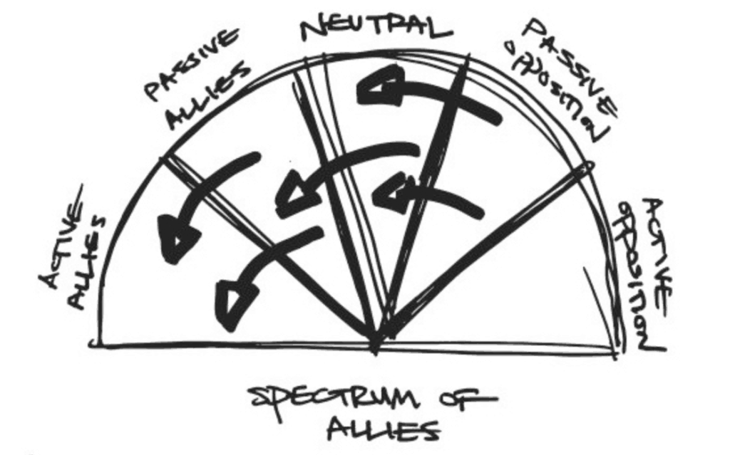
Picking your battles: when Is it worth having a difficult conversation?
Source: George Lakey, Training for Change/ The Commons Social Change Library

Slide 5
Approach 1: LISTEN + shared HUMANITY + STORY
Evidence: facts & figures have limited impact – power of stories AND being listened to/engaged with
Refugee Tales: Power of listening and storytelling
You as volunteer visitor: relationships with people affected by immigration control, and knowledge of their experiences – this is powerful
Walking Inquiry – key demand: Approach to asylum and immigration system based on fundamental human rights, not hostility
Underpinning: shared humanity & justice
Notes:
Structuring and (self-)disciplining everyday life – both temporally and spatially c.f. (Gill, 2013; Fisher et al., 2019)
ATD requirements structure routine and mobility: e.g. getting to reporting appointments, making sure tag is charged
Reporting – regular, coercive, short-distance movements as way of controlling migrants through ‘fixing (them) in place’ (Fisher et al., 2019, p.634).
EM: Idea of ‘tethering’ around reporting – also highly relevant for EM in non-metaphorical sense – physically tethered while charging
Entails high levels of self-discipline: fear of being detained/deported as v strong motivator to organise self to comply
Fear of detention/deportation
E.g. proactive in reporting tech issues

Slide 6
HELPS AVOID being part of the problem
Image: Citizen59 is licensed under CC BY-SA 2.0.
Emphasis on shared humanity/justice/human rights: helps avoid reinforcing ‘deserving’ vs ‘undeserving’ narratives
e.g. refugee excellence stories
e.g. ‘refugees’ vs ‘criminals’, ‘asylum seekers’ vs ‘economic migrants’
Risks in demanding rights for some and not others (as the state sets the parameters for who falls into which category)
Image: Alamy Stock photo

Slide 7
APPROACH 1: how to
1. Listen and acknowledge person’s perspective non-judgementally
‘I hear what you’re saying – why do you feel like that?’
‘That’s interesting, I do want to understand where you’re coming from – could you say a bit more?’
2. Shared humanity/struggle
‘I think wherever we come from, we all want the same things – safety, dignity and a better life for our families’
‘In my experience, we’re all trying to do our best by ourselves and our families’
‘You’re absolutely right that housing and healthcare are a problem in the UK – it’s just a shame politicians try to blame migrants to deflect attention away from all the things they’ve not got right. I think the only way forward is to push for a better system for everyone’
3. Lived experience (anonymised)
‘I visited someone who …’
‘In my experience of visiting…’

Slide 8
PRACTICE TIME!
Surely, they are not all fleeing from wars - what about those who just want to benefit from living in this country.
In pairs: one of you asking question, one of you answering – I’ll let you know when to swap
Before you start: take a couple of minutes to think of 1 or 2 stories you could use
We’re on the council housing list and have been for 6 years. These Albanians clamber straight up the beach and into a council house, or worse still get put into a hotel a working man like me could never afford.
‘They come here and get to stay in hotels and expect to be looked after, they get free accommodation and money for food…’
The NHS and social services are already way overstretched… we have enough problems of our own

Slide 9
APPROACH 2: key fact based
- Most people do not come to UK – majority of refugees and migrants are in the Majority World, other countries in Europe host far more people
- Home Office’s own research on asylum decision making: people have little knowledge of housing/benefits/healthcare in UK. People’s decision to come to the UK are more to do with historical/family/community ties to the UK – e.g. speaking English, big diaspora already here
- People have the right to claim asylum wherever they want. Geography is not an excuse (if UK won’t accept people, other countries can say the same)
- The evidence suggests that there is net economic benefit of migration – people work, pay taxes and contribute more to welfare state than take out

Slide 10
In action
https://www.jcwi.org.uk/blog/rebuttals-tackling-myths-and-inaccuracies-on-channel-crossings
https://www.youtube.com/watch?v=njUJyWX29gE&t=3s

Slide 11
REFERENCES & resources
- Joint Council for the Welfare of Immigrants – www.jcwi.org.uk - good policy briefings – if you want facts/figures/key points around specific policy areas, e.g Channel boat arrivals
- JCWI – ‘key fact’/myth busting approach: https://www.jcwi.org.uk/blog/rebuttals-tackling-myths-and-inaccuracies-on-channel-crossings
- UNHCR – Statistics on refugee hosting: https://www.unhcr.org/refugee-statistics/
- Home Office Research on why asylum seekers come to UK: https://freemovement.org.uk/home-office-research-report-on-why-asylum-seekers-come-to-the-uk/
- Net economic benefits migrants: https://migrationobservatory.ox.ac.uk/resources/briefings/the-fiscal-impact-of-immigration-in-the-uk/
- Deep Canvassing (for more in-depth approach to listening/shared struggle approach to difficult conversations): People’s Action Institute – Deep Canvass Report https://peoplesaction.org/wp-content/uploads/2020/07/PA-Deep-Canvass-Final-Report-v5.pdf

